Slide 1
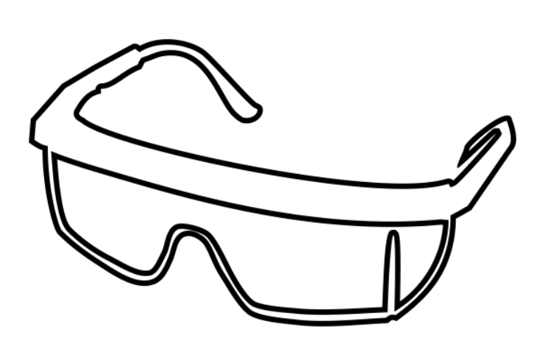
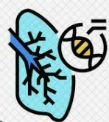
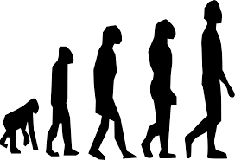
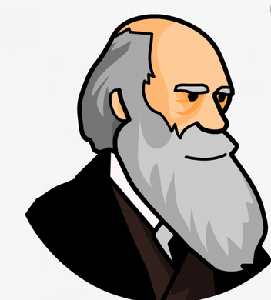
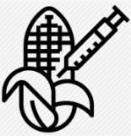
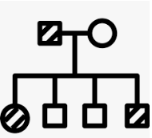
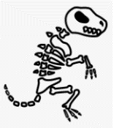
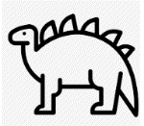
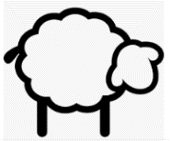
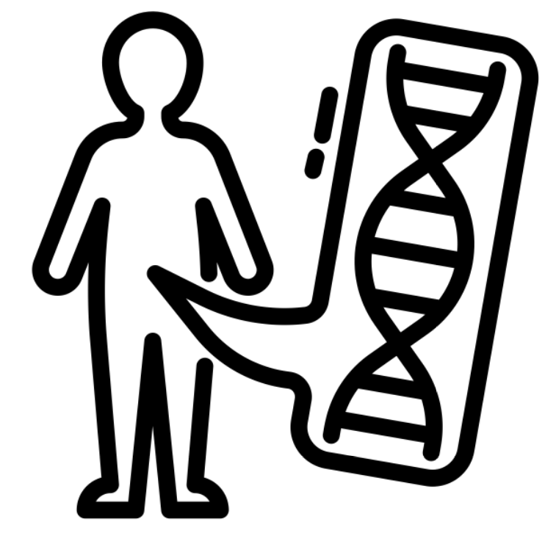
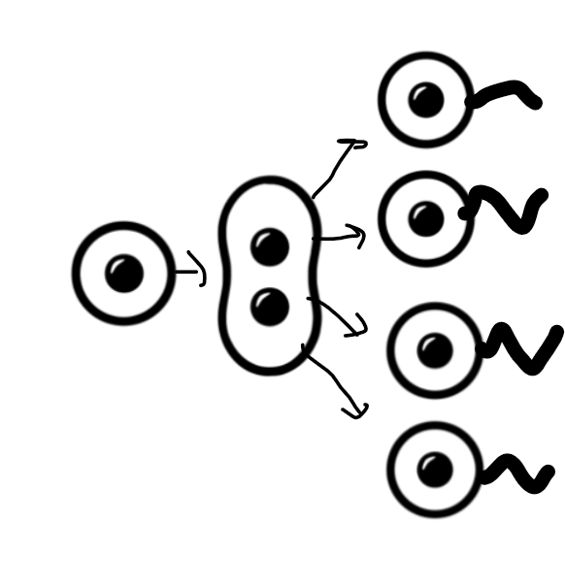
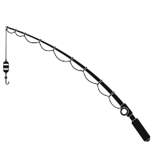
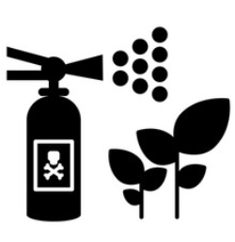
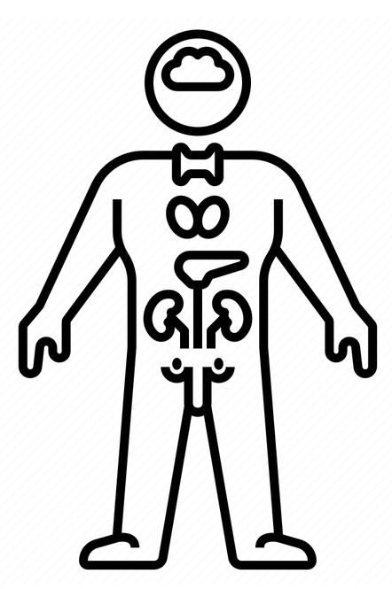
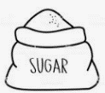
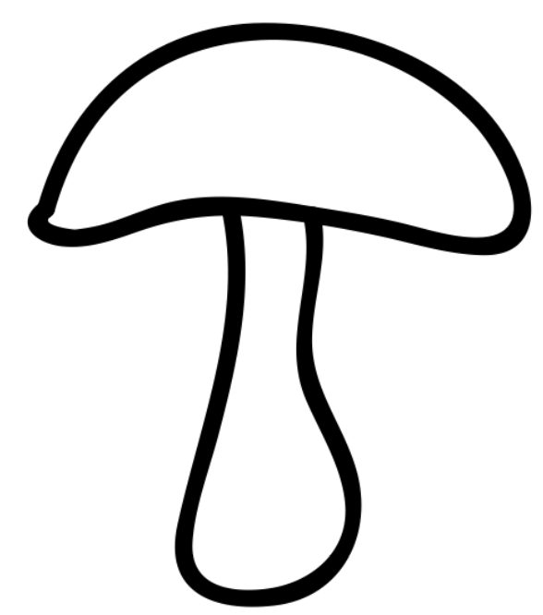
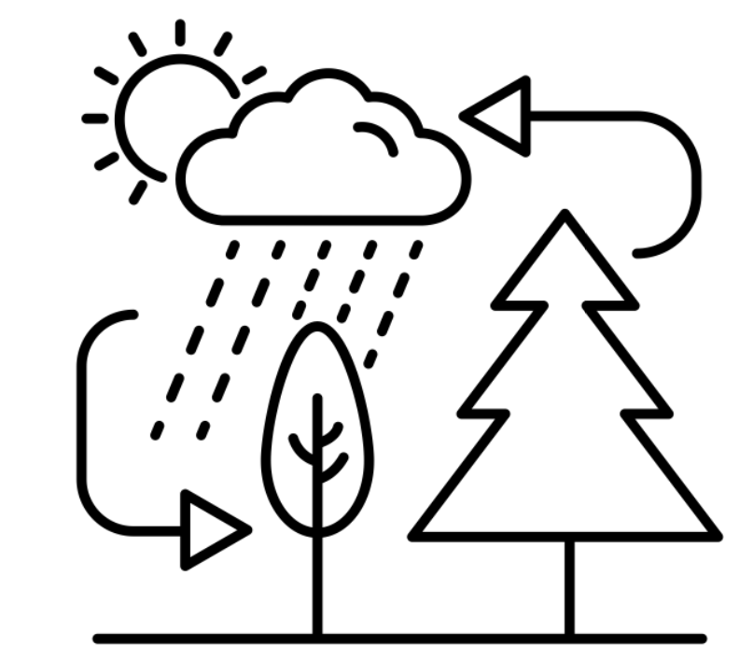
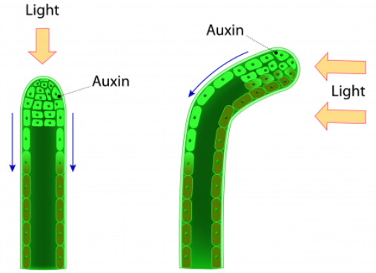
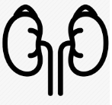
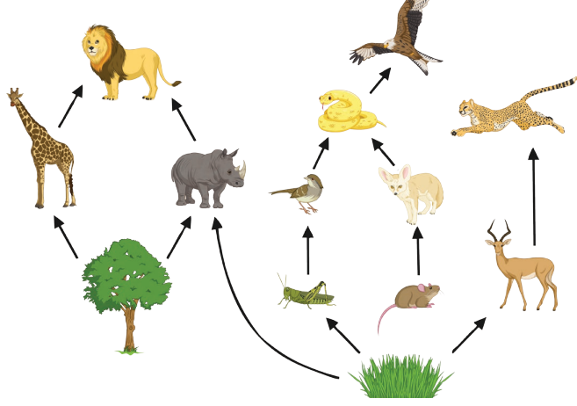
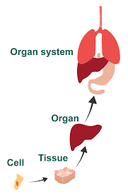
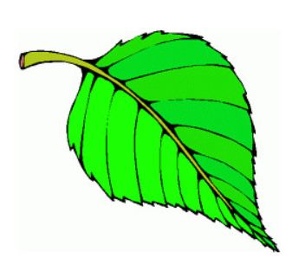
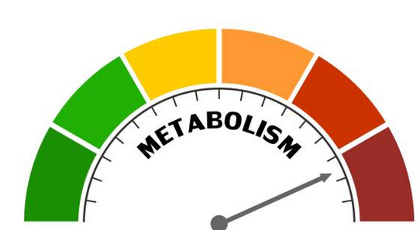
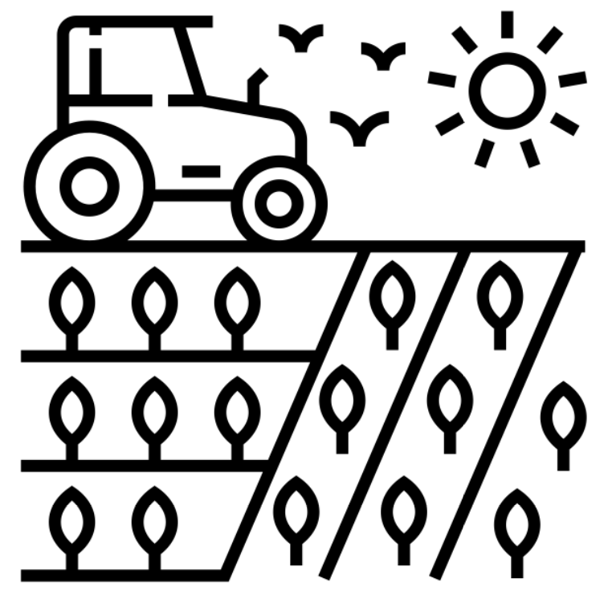
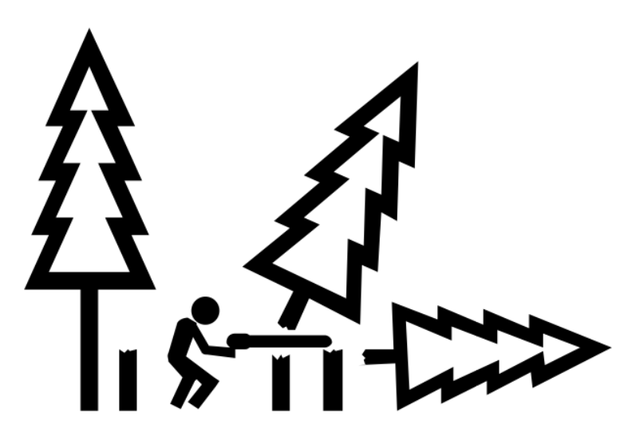
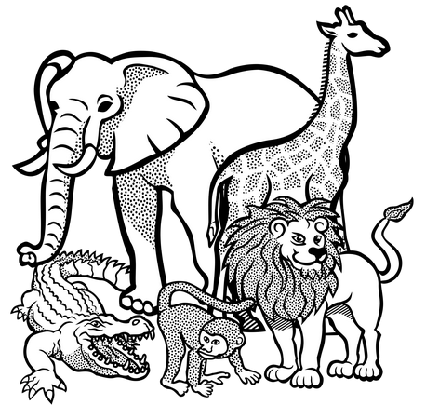
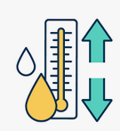
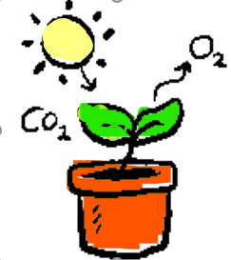
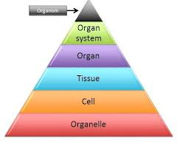
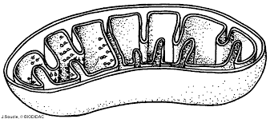
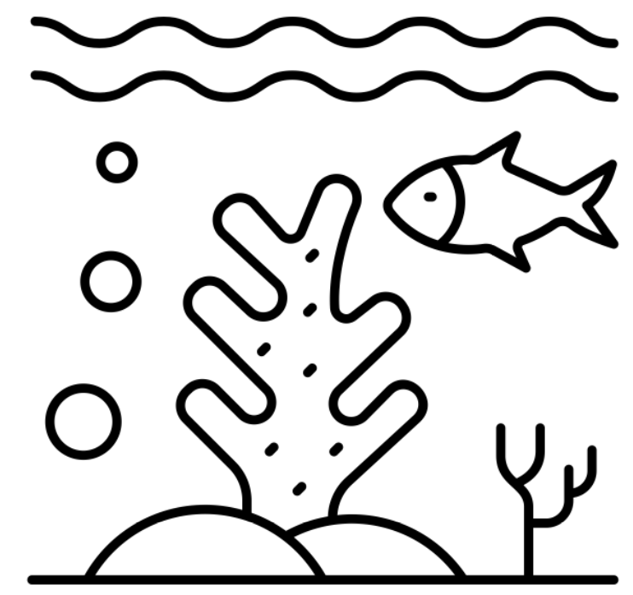
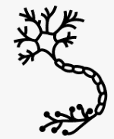
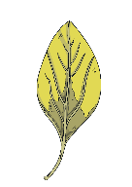
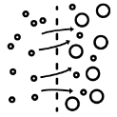
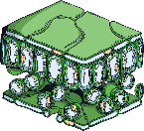
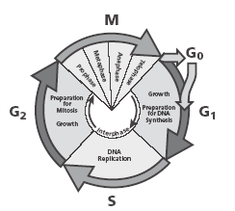
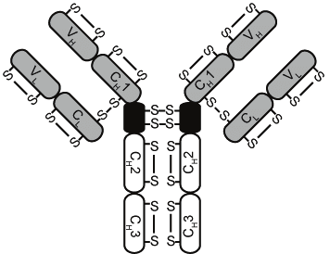
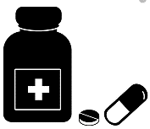
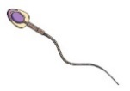
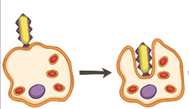
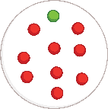
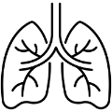
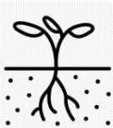
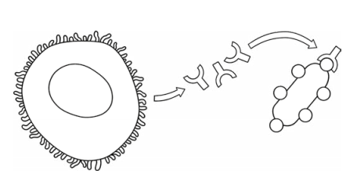
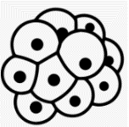
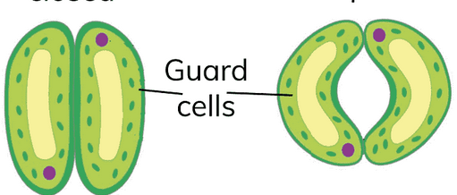
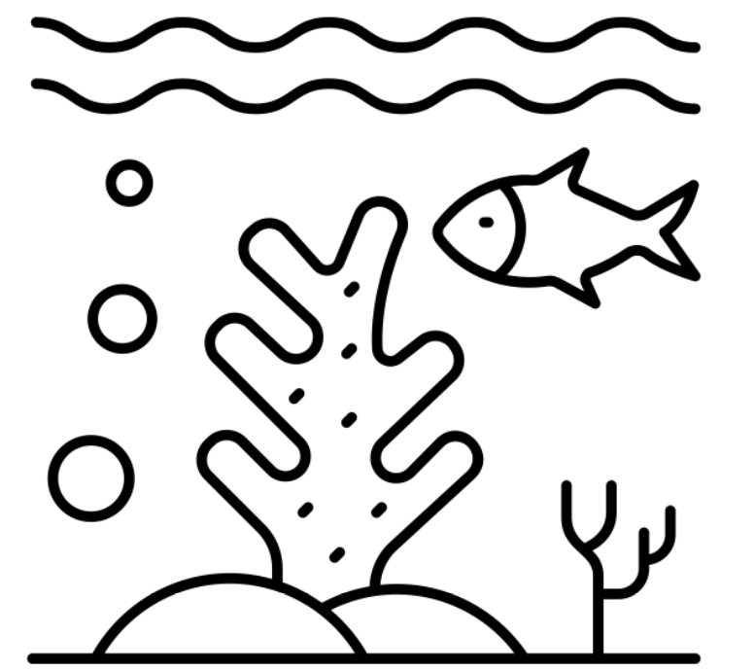
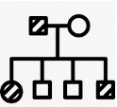
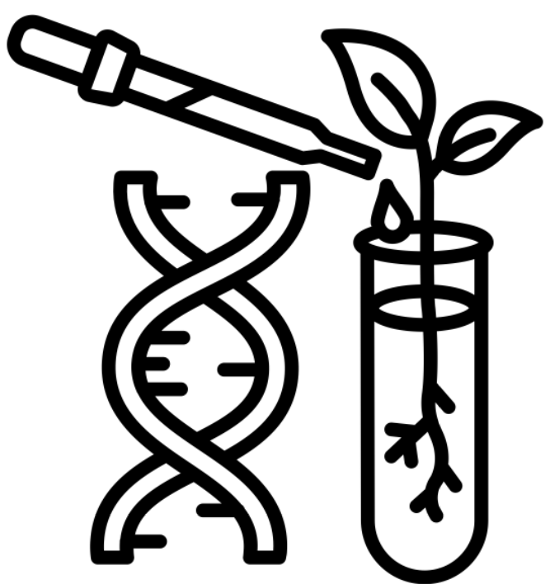
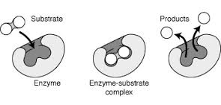
BIOLOGY
Learning journey
St John Henry Newman Catholic School
Understanding variables
Assessing impact of scientific concepts
Drawing conclusions
Applying maths to the scientific concepts
Evaluation of scientific concepts
Writing
methods
Describe patterns
Year 7
Understanding and Applying Scientific Skills
Year 13
Drawing graphs and analysing graphical data
Analysis of secondary data
Modelling scientific concepts
Understanding relationships between science and society
IDEAL
Identify, describe, explain, apply, link
Risk Assessment
Evaluating data & investigations
CF
Sex determination
Theory of Evolution
Genetic engineering
GCSE exams
A Level Sciences – Biology, Chemistry & Physics
(Need grade 6 and grade 6 in Maths)
Inherited disorders
Variation
Evolution
Applied Science A Level
Evolution
GM
Genetic inheritance
Fossils
Extinction
Speciation
Selective Breeding
Cloning
Other post 16 options Apprenticeships, college, other A level subjects)
DNA and the genome
Genetics
The history & understanding of genetics
DNA structure
& protein synthesis
Meiosis
Farming techniques
Sustainable fisheries
Uses of Pant hormones
Negative feedback
Controlling blood glucose
Hormones human reproduction
Endocrine system
Advantages & disadvantages of sexual & asexual reproduction
Sustainability
Hormones
Hormones
Environmental change
Sexual and asexual reproduction
Factors affecting food security
Sustainable food production
Pant hormones
Maintaining water & nitrogen balance
Infertility
Contraception
How materials are cycled
Decomposition
Energy
in
Ecosystems
Pyramids of Biomass
Trophic levels
Levels of organisation
Rate of photosynthesis
Uses of glucose
Digestive system
Metabolism
Waste management
Land use
Deforestation
Communities
Classification
Homeostasis
Reflex arc
Thermoregulation
Photosynthesis
Digestion
Respiration
Biodiversity
Ecosystems
Homeostasis
The Brain
Photosynthesis
Aerobic & anaerobic respiration
Response to exercise
Biodiversity
& maintaining it it
Global warming
Adaptations
Abiotic and Biotic factors
Structure of the eye
Eye problems
Structure & function of the nervous system
Monoclonal antibodies
Plant defences
Plant Disease
Cancer
Risk factors
The Blood & blood vessels
Heart
Osmosis
Diffusion
Plant tissues
Communicable disease
Mitosis & cell cycle
Discovery and development of drugs
Defence against disease
Non-com diseases
Organisation
Transport in cells
Plants
Communicable disease
Microbiology
Vaccination
Division
White blood cells
Lungs
Levels of
Organisation
Active Transport
Transpiration
Translocation
Resistant bacteria
Stem cells &
Therapeutic cloning
Correlation causation
Cardiovascular disease
Exchange
surfaces
Viral, bacterial, fungal, protist disease
Cell
specialisation
Cells
Microscopy
Prokaryotes and Eukaryotes
Plant & Animal Cells
KS4
Digestive system
Charles Darwin
Genetic modification
Anaerobic Respiration
KS4
Food tests
Plant minerals
Gas Exchange
Breathing
Nutrients
Biodiversity
Inheritance
Photosynthesis
Leaves
Breathing Digestion
Evolution Inheritance
Respiration Photosynthesis
Drugs, alcohol & smoking
Unhealthy diet
Bacteria and enzymes in digestion
Natural selection
Extinction
Genetics
DNA
Aerobic Respiration
Biotechnology
Investigating photosynthesis
Plant
Flowers & Pollination
Movement of substances
Skeleton
Seed dispersal
Disruptions to food chains & webs
Development of a fetus
Reproductive systems
Adapting to change
Observing cells
Joints
Human
Reproduction
Muscles
KS3
Reproduction
Interdependence
Variation
Cells
Movement
Fertilisation & Germination
Ecosystems &
Food chains & webs
The Menstrual cycle
Fertilisation & implantation
Adolescence
Continuous & discontinuous
variation
Uni-cellular organisms
Plant, animal & specialised cells
Levels of organisation
Competition
CROSS-CURRICULAR LINKS
Body systems
PE
Health and disease
History
Reproduction
PSHE
Data analysis
Mathematics
Health & Lifestyle
PSHE
Photosynthesis
Chemistry
C, N and H₂O cycle
Geography
Diffusion & Osmosis
Chemistry

