Slide 1
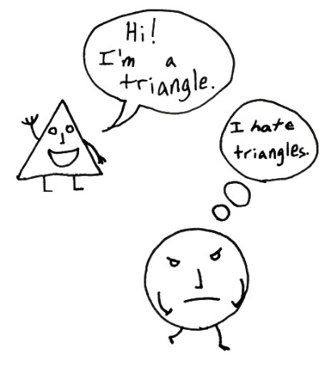
c/w date What are prejudice and discrimination?
Presentation & Standards
“Only our best will do”
Reading book and equipment on desks.
Write in black pen; underline using a ruler.
Copy date and title.
Copy key vocabulary.
Complete the task.
Key Vocabulary
Prejudice
Discrimination
Stereotype
Now do this…
On your mini-whiteboard
What do you think the key vocabulary means? Try to write a definition of each word. If you can’t write a definition, could you give an example?
St John Henry Newman Catholic School

Slide 2
& RESPECT

Slide 3
How this fits into today’s lesson
& RESPECT
Our topic this half term is about prejudice and discrimination. We will explore reasons why some people do not show tolerance and respect to others and why this is so important.

Slide 4
Judging someone based only on a characteristic that they cannot control e.g. race, gender, sexuality, disability, religion
Prejudice is a THOUGHT
Based on an opinion
Not backed up by facts and statistics
Usually negative
Definitions
Characteristics
Can you use the word ‘prejudice’ correctly in a sentence?
Prejudice
Thinking that blondes are dumb
Thinking that white people are superior to black people
Thinking that only a man can be a doctor
Assuming all Muslims are terrorists
“That person punched me so I don’t like them”
“Miss Lowrey hates cabbage because it tastes horrid”
Examples
Non-examples

Slide 5
Treating someone worse than other people based only on a characteristic that they cannot control e.g. race, gender, sexuality, disability, religion
Discrimination is an ACTION
Based on an opinion
Not backed up by facts and statistics
Always upsetting
Can be seriously damaging
Definitions
Characteristics
Can you use the word ‘discrimination’ correctly in a sentence?
Discrimination
Refusing to give a promotion to someone just because they are a woman
Paying a black person less than a white person for the same job
Landlords refusing to rent houses to young people because “all young people are messy”
Violence against various groups of people based on race, religion, sexuality etc
Students having to wear school uniform when staff don’t
A teacher giving the same detention to a male and a female student who BOTH didn’t do their homework
Examples
Non-examples

Slide 6
A simple, conventional idea of what a whole group of people are like
Often popular and well-known opinions.
Gives an image that the whole group is the same.
Often hurtful.
Definitions
Characteristics
Can you use the word ‘stereotype’ correctly in a sentence?
Stereotype
Men are physically strong.
All Americans are obese and lazy.
All Muslims are terrorists.
All teenagers are rude.
Interestingly, this word comes from the printing industry. ‘Stereo’ means solid and ‘type’ means printed letters and refers to a method of printing where solid letters would be arranged on a plate and printed so that every copy of the page would be exactly the same. The word now means assuming all people with a particular characteristic are the same like the pages that were printed.
Examples
Etymology

Slide 7
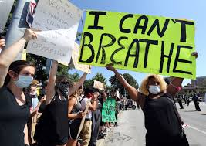
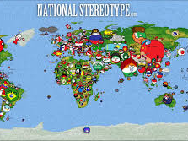
Create a spider diagram of examples of prejudice, discrimination and stereotyping that you can think of. Use these images to help you. Try to be specific.
Notes:
Teachers should steer conversations and ideas. Discuss things that exist today and break down the potential misconception that these things don’t happen anymore or not in Britain. Encourage students to write specific examples instead of just ‘racism’ and ‘sexism’. National stereotypes, unequal gender treatment, Islamophobia, xenophobia, ageism, LGBT discrimination, gender stereotypes, racial stereotypes, racist discrimination past and present. Students should be able to draw on some of their history work where they will have already studied the slave trade, segregation, the Civil Rights Movement, women’s suffrage and the British Empire in India. Students could be encouraged (but not forced) to share personal experiences.

Slide 8
Written reflection task
How are prejudice and discrimination harmful? Try to use a number of different examples and a number of different impacts that they can have. Aim to write a paragraph of at least 5 sentences.
How can we fight against prejudice and discrimination? Aim to write at least 4 examples.
Why is it important to challenge prejudice and discrimination when we encounter it? Try to give at least 3 reasons.
Notes:
Work up the traffic lights

Slide 9
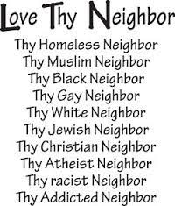
What does the Catholic Church teach about prejudice and discrimination?
Notes:
Discussion task. Start by asking students to recap key Catholic beliefs in terms of human dignity, imago dei, love thy neighbour

Slide 10
Galatians 3: 28 “There is neither Jew nor Greek, there is neither slave nor free, there is no male and female, for you are all one in Christ Jesus.”
Discussion points:
What do you think this quote means?
Why do you think this is a key teaching of the Catholic Church?
How does this apply to today’s topic?

Slide 11
Reflection
https://www.youtube.com/watch?v=VPf6ITsjsgk
Are you born with prejudice?
Is it learned behaviour? From family? From friends?
Why do Catholics and others have to ‘teach’ people not to discriminate? Most people know that it is wrong. Why don’t we just not do it?
Notes:
Play the song and reflect on the lyrics. The song is from a musical called South Pacific in which the main American male singer is in love with a Vietnamese girl and he is singing about why prejudice happens. He suggests that prejudice is something that is taught to children by their families.

Slide 12
Where can I get support?
How to access advice/guidance/support with any of the issues raised in this lesson
In school – talk to your teacher or form tutor
In school – talk to Student Support Team
At home – talk to parents/guardians/trusted adult
Kooth – linked on the school website

